Slide 1
DSA LAB(3b1) FINAL PROJECT 2020 REPORT ON PROJECT
Course instructor : Miss Maleeha Shah Student Details : Muhammad Danish - cs18019 - 3B
Project Name : Laptop Store management system
More on project: This project is on Laptop Management system. Coded in C++ using visual Studio 2010. Project uses Doubly link list algorithms, Filing, and searching and sorting algorithms.
Functionality of App : | Add Laptops | Delete Laptops | Sell Laptop
| Show Inventory | Search Buyer | Search Laptop
| Sort Products
| See Number of Products.

Slide 2
Introduction
How this application works ?
When program starts the user will be given options that are chosen by a integer input. Integer is checked and program will jump to respective control. The added data is stored in link list with a data code given by user. User can delete a laptop with product code, sell a laptop with product code, sort the products , search for a previous costumer and can search in inventory.
How data structure is working ?
A Doubly link list class files is used for all the functions and algorithms. These functions are used according to the control of program. Searching buyer data is done with sentinel search and sorting products is done with bubble sort directly on link list. As linear search works best on link list. Because of dynamic size. Its used for searching in link list. Linear Arrays are used to search for the user data. The previous data is fetched form the file and stored in the array. The array size is dynamic and is dependent on the size of data present.

Slide 3
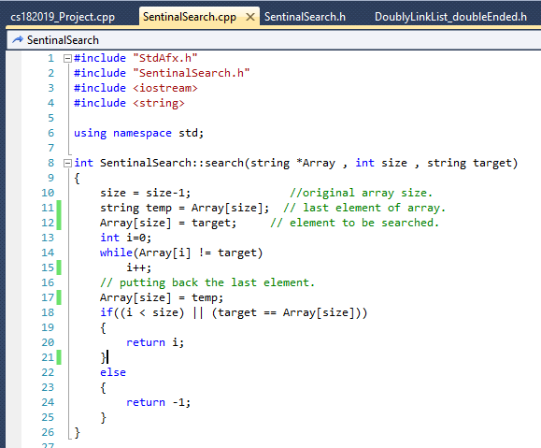
CODE SCREENSHOTS
Sentinel search algorithm The search algorithm work same as Linear search. But with advantage of not checking the array limit in every loop. The value to be searched is inserted in the last of the array. And it works as a exit condition for index count of the array.

Slide 4
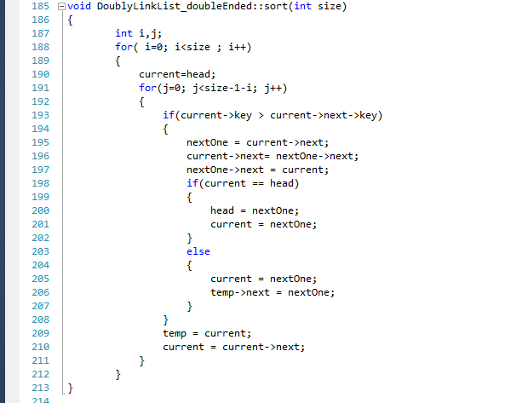
Bubble Sort on Link List algorithm.
The bubble sort algorithm is directly implemented on the nodes of the
Link list.
The data is sorted in ascending order. On the basis of product codes. The Nodes are swapped when the condition of greater gets true.

Slide 5
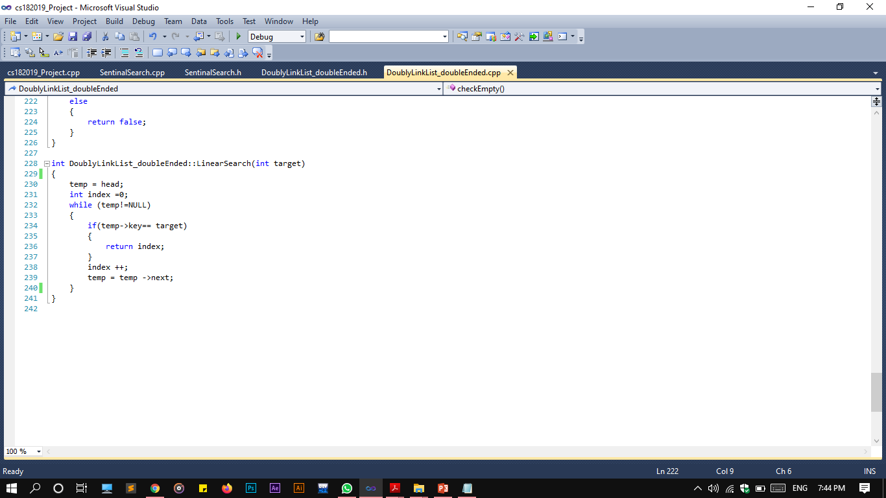
Linear Search Algorithm on Link list.
Search is working on the product code(node->key) stored in nodes. Traversing in done on the whole list. When the key is matched the index is returned.

Slide 6
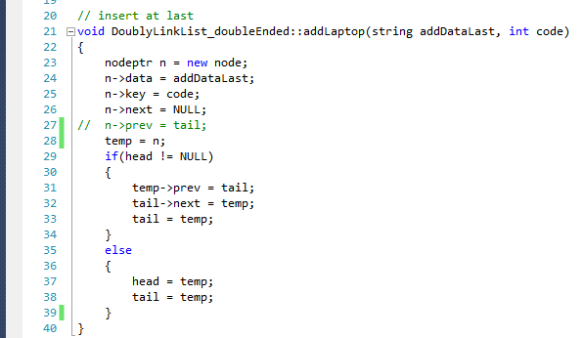
Add Laptop
Data Structure: Doubly link list.
The entered laptop with the product code is stored in the node.
When the link is not empty that means the head is not null.
Then user can search , sell, sort, show the inventory stored in the link list.
Algorithms of link list Contains:
Add laptop. Delete laptop. Sort laptops. Search Laptop.
Sell laptop.

Slide 7
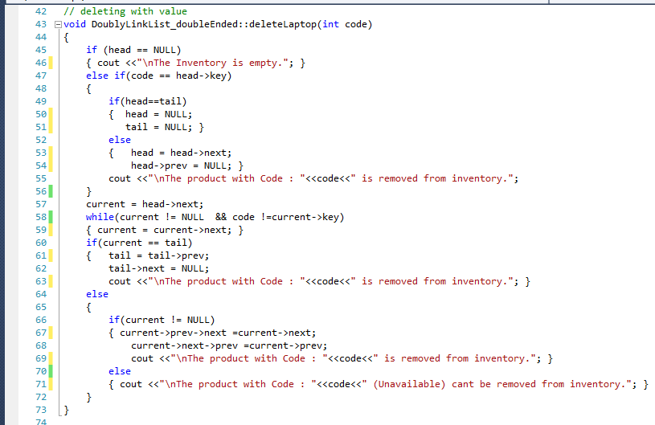
Deleting Laptop

Slide 8
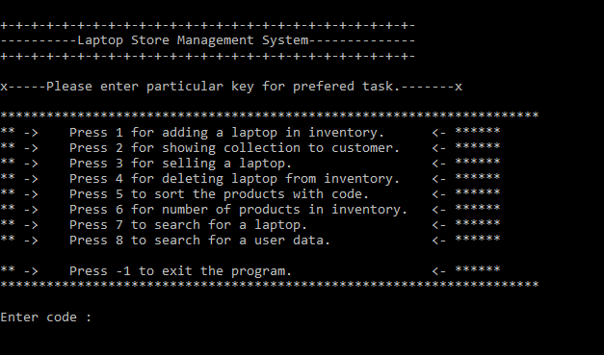
CODE OUTPUT SCREENSHOTS
Main control Instructions.
Printed everytime after a user is done with a task.
If and else-if is used to check for the valid entered code.
Otherwise program will loop back to start with a “invalid code error”.

Slide 9
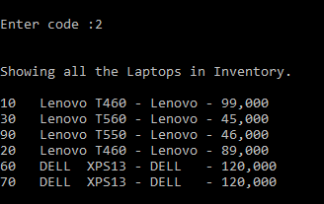
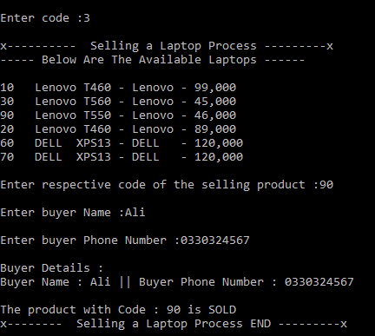
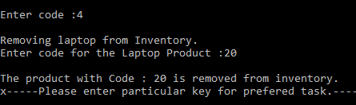
Selling from list
Printing list
Deleting from list

Slide 10
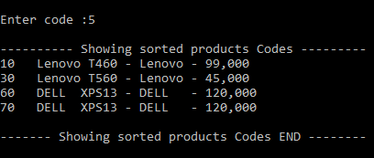
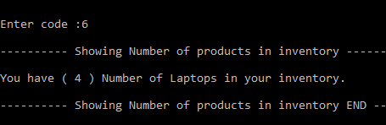
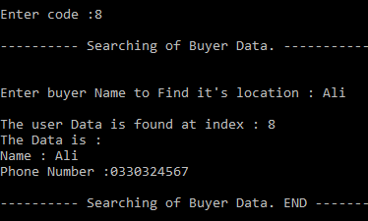
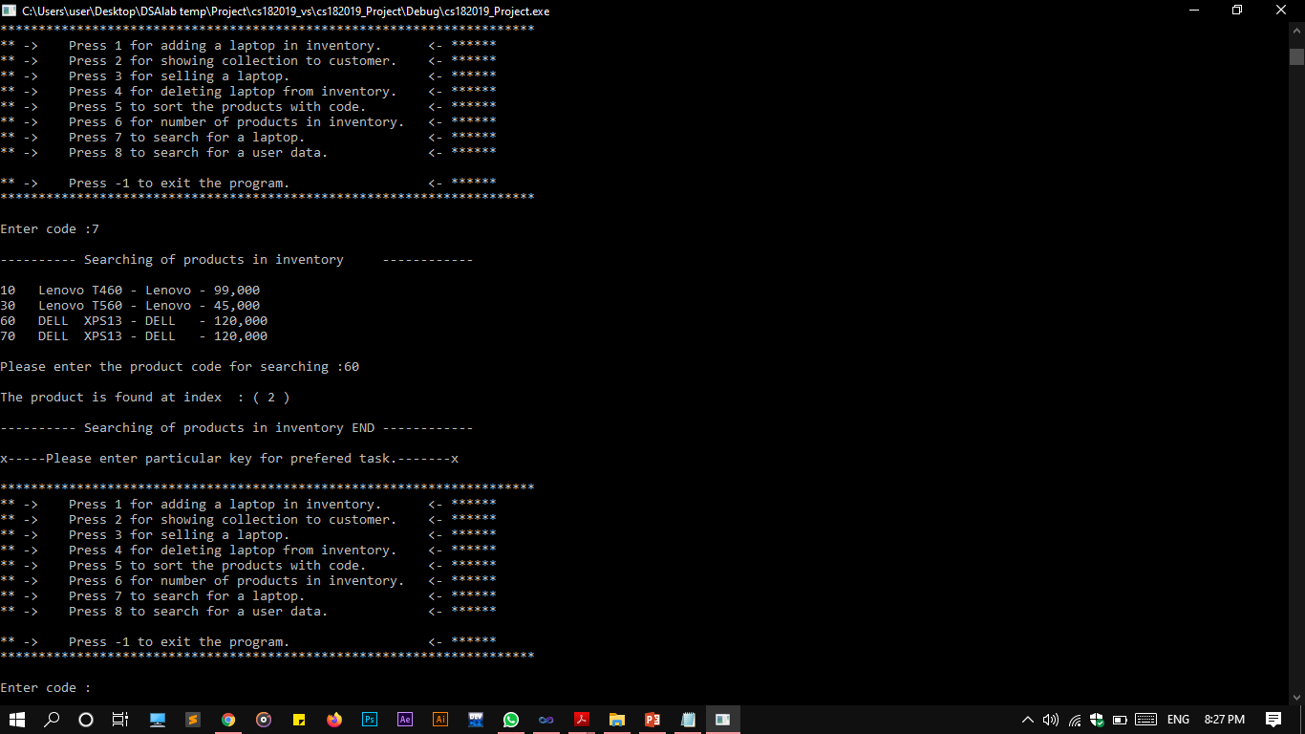
Sorting the list
Printing list
Number of items
Search buyer data
Searching the list

Slide 11
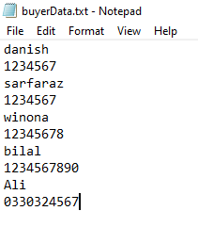
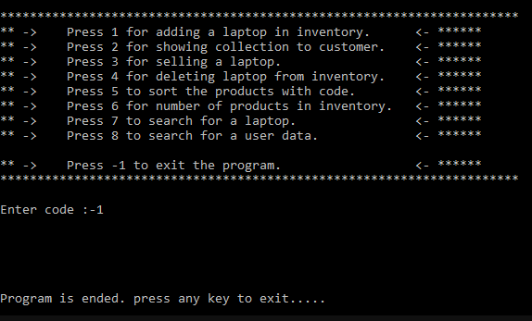
Buyer Data in file
Exit Code
X-------------------------------------------------------------------------------------------------------------------------------X
Cs182019 | Muhammad Danish | Section-3B

